Slide 1
Aircraft Optimisation
Milestone 2

Slide 2
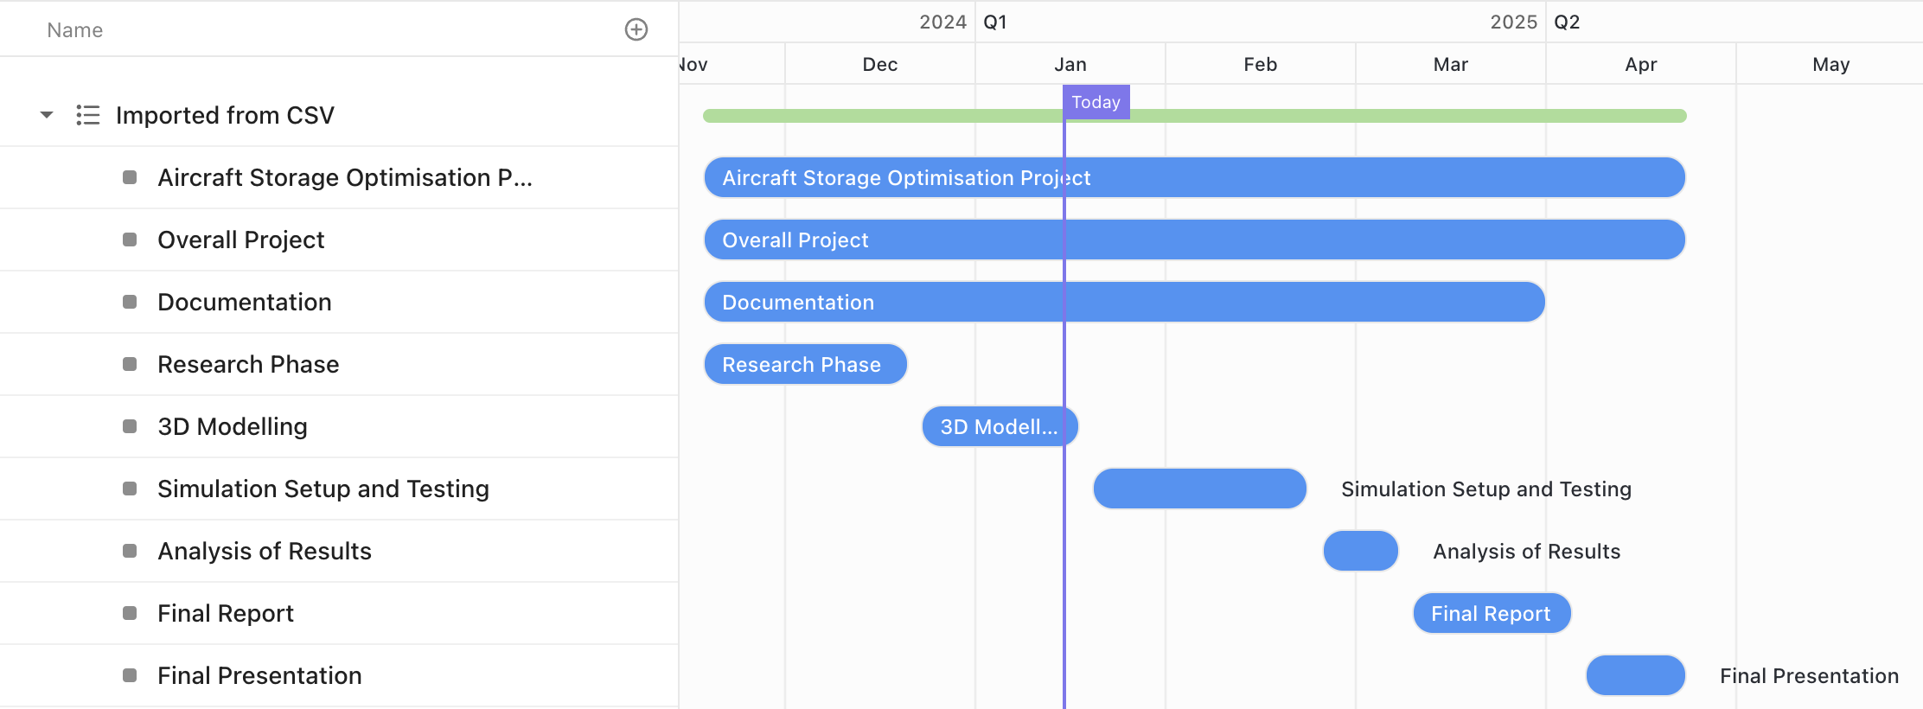
Gantt Chart Overall

Slide 3
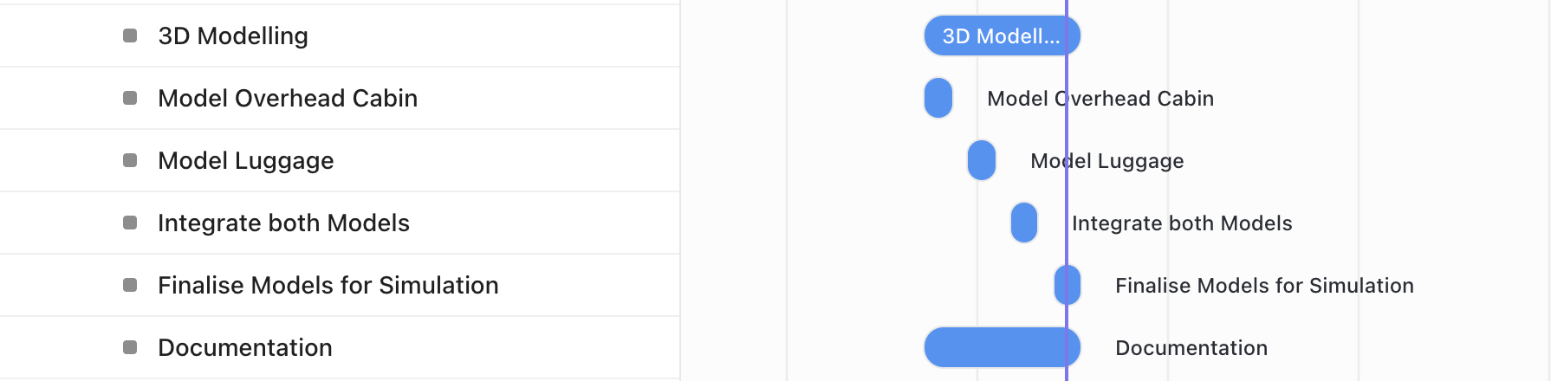
Gantt Chart Current Progress

Slide 4
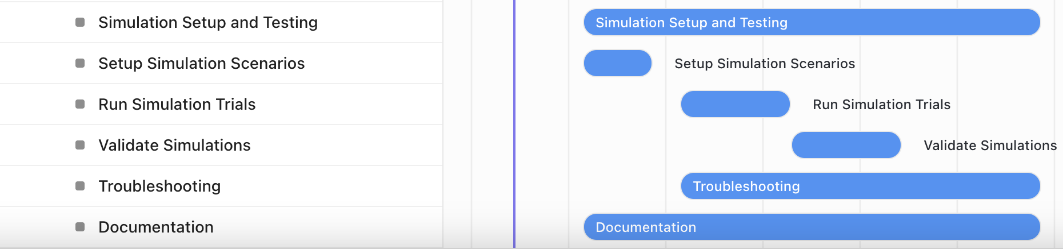
Gantt Chart Expected Progress

Slide 5
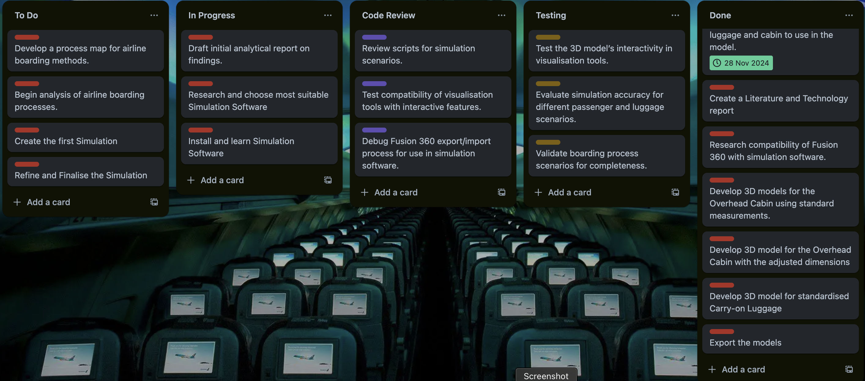
Trello

Slide 6
Trello – Meetings and Feedback
Meeting 1:
Briefing
Explain the overview of the project
Explain what outcomes are to be expected
Explain the purpose of the project
Feedback
Potential problems regarding scale
Potential errors regarding simulations
Create a GitHub Project Repository
Create Trello to organise tasks
Create Gantt Charts for the project
Meeting 2:
Briefing
Show the Project Overview document
Explain the purpose of the project
Discuss the solutions to the last meeting's problems
Feedback
Finalise Trello
Finish making the GitHub Project Repository
Compile Gantt Charts
Bring all documents and completed tasks to the next meeting
Meeting 3:
Briefing
Go through Trello
Show GitHub
Show Gantt Charts
Feedback
Justification for 3D software
Benchmarks for comparison
PowerPoint on what I have done so far
Summary of everything done for ease of explanation
Meeting 4 (Milestone 2):
Briefing
Go through this PowerPoint explaining everything
Show report – Introduction, Literature & Technology Review and Methodology
Show and explain current progress regarding the Artefact – 3D Modelling phase
Current analysis regarding optimisation
Feedback
Everything was well-planned
Visually impressive via the PowerPoint
The report was well-written and highlighted key features
Add and improve the evaluation section, testing the system's efficiency

Slide 7
Software Analysis
Category | Technology | Key Features | Benefits | Limitations | Cost | Ease of Use | Community Support
3D Modelling | Fusion 360 | 3D modelling, parametric design, simulation | Accurate modelling, cloud collaboration, integrates simulation | Subscription needed, limited rendering features | Free for students, ~$495/year for commercial | High | Strong
3D Modelling | Blender | 3D modelling, rendering, animation | Free, open-source, customizable, extensive plugins | Time-intensive for beginners, lacks engineering-focused tools | Free | Moderate | Large, highly active
3D Modelling | SolidWorks | 3D CAD, engineering-focused tools | Industry-standard, highly precise | Expensive, steep learning curve | ~$3,995/year | Moderate | Strong
Simulation | Unity | Real-time simulation, agent-based modelling | Immersive simulations, supports interactive interfaces | Steep learning curve, requires scripting knowledge (C#) | Free for personal use, Pro ~$2,000/year | Moderate | Strong
Simulation | AnyLogic | Simulation modelling, agent-based modelling, discrete-event simulation | Combines multiple modelling paradigms, excellent for system simulations | Expensive for commercial use, steep learning curve | Free for personal use, Pro/Business ~ $3000 | Moderate | Moderate
Simulation | MATLAB/Simulink | Data modelling, simulation, dynamic systems | Advanced engineering simulations, real-time data integration | Expensive license, steep learning curve | ~$2,000/year (depends on package) | Moderate | Moderate
Data Analysis | R | Statistical computing, data analysis | Excellent for statistics, visualisation packages | Steep learning curve | Free | Moderate | Strong
Data Analysis | Python Libraries | Data visualization (Plotly, Matplotlib), simulation tools (SimPy) | Free, customizable, broad functionality | Requires programming skills, development time for complex tasks | Free | Moderate to High | Large, active on GitHub
Data Analysis | Excel | Spreadsheet-based data analysis | Widely available, user-friendly interface | Limited for large datasets, lacks automation | ~$6.99/month (Microsoft 365 subscription) | Very High | Strong
Visualisation | Unreal Engine | Real-time rendering, photorealistic visuals | High-quality visualization, VR/AR ready, free for small projects | Resource-intensive, steeper learning curve for advanced tasks | Free for non-commercial use, royalties apply for large projects | Moderate | Strong
Visualisation | Unity | Real-time 3D rendering, VR/AR capabilities | Immersive simulations, supports interactive interfaces | Steep learning curve, requires scripting knowledge (C#) | Free for personal use, Pro ~$2,000/year | Moderate | Strong
Visualisation | Tableau | Interactive dashboards, visualisation | Easy-to-use, excellent for presenting insights | Requires licensing | ~$70/user/month | Very High | Strong

Slide 8
Software Chosen
1. Fusion 360: Modelling
Overview:
A CAD software used for creating precise 3D models of the overhead cabin.
Supports detailed design and scalability for various aircraft configurations.
Rationale:
Intuitive interface for intricate modelling.
Advanced tools for ergonomic and spatial analysis.
Integration:
Exported models are compatible with simulation and visualisation platforms.
2. AnyLogic: Simulation
Overview:
A simulation software used to model and analyse system performance under real-world scenarios.
Evaluate storage capacity, passenger interaction, and cabin efficiency.
Rationale:
Ideal for complex system dynamics and scenario testing.
It supports the integration of CAD data for realistic simulation.
Integration:
Imports Fusion 360 models to simulate design functionality under varied conditions.
3. Python: Data Analysis
Overview:
Used to process and analyse research data, simulation outputs, and feedback metrics.
Libraries like Pandas and Matplotlib provide data manipulation and visualisation capabilities.
Rationale:
Efficient for handling large datasets and generating actionable insights.
Enables statistical analysis and trend identification.
Integration:
Data from simulations and user studies are processed to refine design iterations.
4. Unity: Visualization
Overview:
A game engine creates interactive 3D visualisations of the overhead cabin design.
Enables immersive demonstrations for stakeholders.
Rationale:
Facilitates real-time interaction and visualisation of the final product.
Enhances stakeholder understanding through virtual exploration.
Integration:
Imports 3D models from Fusion 360 and integrates simulation data for realistic interactions.

Slide 9
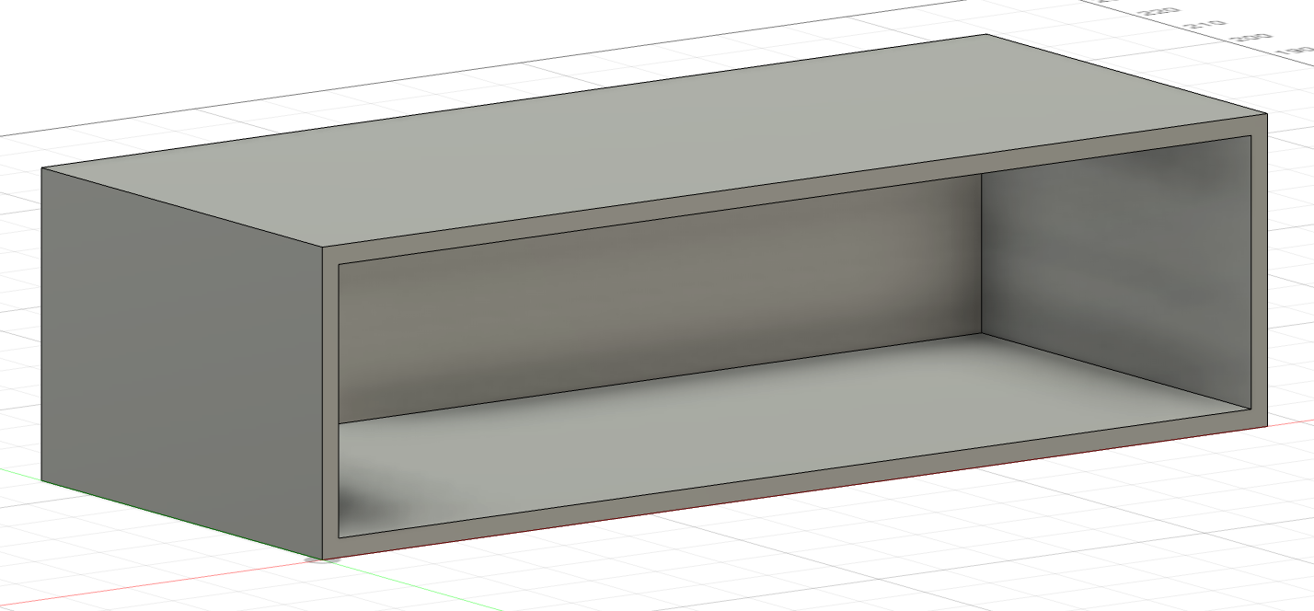
3D Models – Overhead 1
1450mm
400mm
610mm

Slide 10
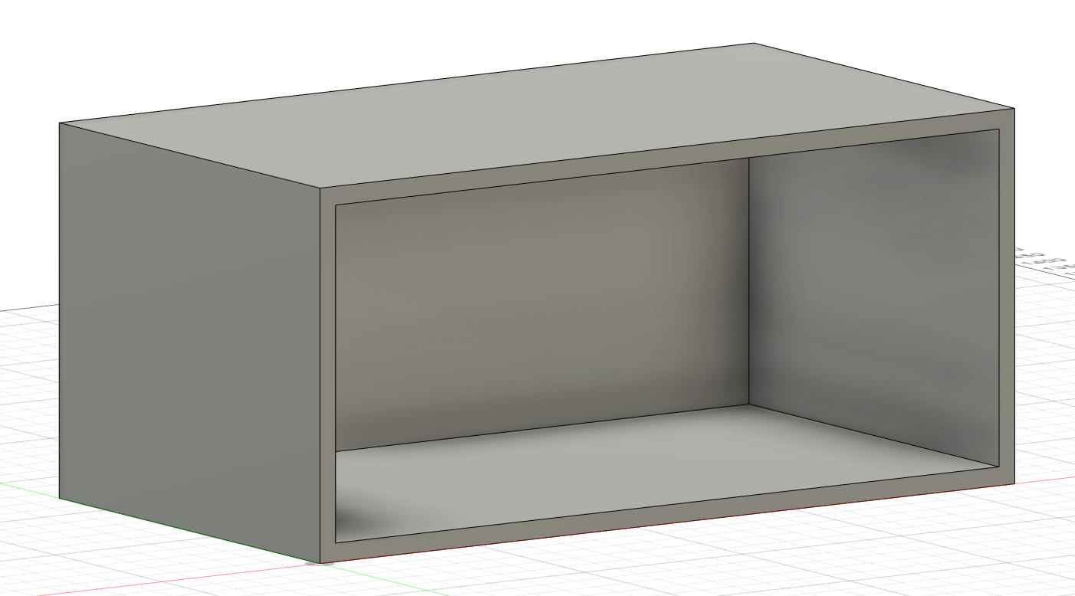
3D Model – Overhead 2
1100mm
500mm
610mm

Slide 11
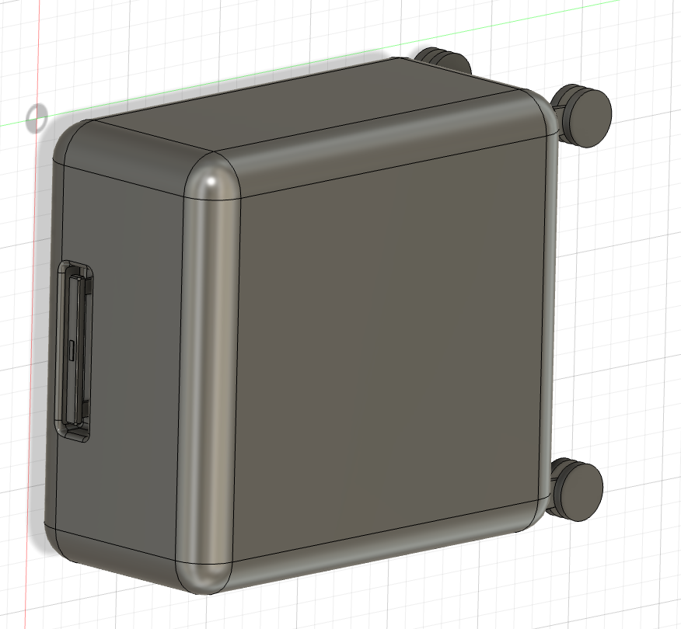
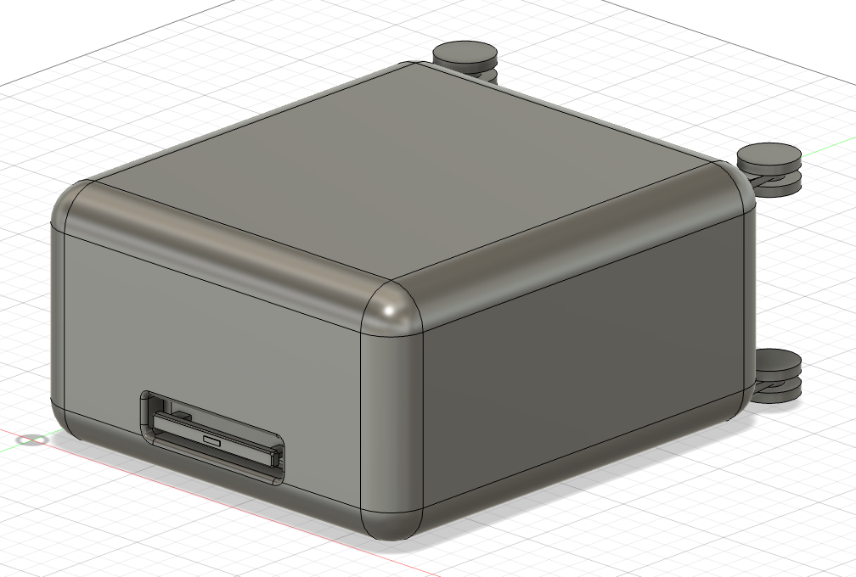
3D Model – Carry-on Luggage
560mm
560mm
250mm
450mm
450mm
250mm

Slide 12
Optimisation Analysis
Generic Aircraft Size ~ 30-40metres
LCM for the 2 Overhead Model – 3190cm/31.9metres
Overhead 1: 3 per Bin – 22 Bins – 66 Carry-ons
Overhead 2: 4 per Bin – 29 Bins – 116 Carry-ons
Percentage Increase: 80%
Dimension Change: Lower the Overhead by 10cm

Slide 13
Evaluation Process
1. Quantitative Performance Metrics
Metrics Used:
Boarding Time: Measure average boarding and luggage storage duration.
Storage Utilisation: Assess the percentage of overhead bin space effectively used.
Passenger Satisfaction: Simulated proxies to infer convenience and efficiency.
Approach:
Compare baseline (current practices) with optimised configurations.
Analyse data using Python libraries (Pandas, NumPy).
Testing:
Unit Testing: Validate each metric’s calculation.
Integration Testing: Ensure data flows seamlessly from simulation to analysis.
2. Technical Validation Through Testing
Unit Testing:
Test individual components (e.g., 3D model, simulation scenarios, visualisation modules).
Integration Testing:
Validate end-to-end workflow (Fusion 360 → AnyLogic → Python → Unity).
Ensure accurate data exchange and compatibility between tools.
Goal:
Guarantee reliability, scalability, and real-world applicability of the digital twin artefact.

